Slide 1
LIBRARY MANGEGMENT USING linked list presented by: Ch.VISHNU RACHANA D.JASWIKA G.ANANYA E.MADHURI

Slide 2
INTRODUCTION
A Library Management System is a software application designed to manage books within a library. This basic version uses the C programming language and linked lists to perform operations such as adding, deleting, searching, and displaying books. Each book in the library is uniquely identified by an ID and also contains a title and author.

Slide 3
OBJECTIVE
The objective of this project is to implement a simple, console-based Library Management System using linked lists in C. The program should allow the librarian to:
Add a new book
Delete a book by its ID
Search for a book by its ID
Display the list of all books
This project helps in understanding dynamic memory allocation, pointer manipulation, and the concept of linked lists in C.

Slide 4
Why C and DSA?
Foundation of Programming C provides a strong foundation in understanding how memory and low-level operations work, which is essential for mastering DSA concepts like pointers, arrays, and memory management.
Efficiency and Performance C is a high-performance language that allows fine-grained control over system resources, making it ideal for implementing efficient algorithms and data structures.
Industry Relevance and Interviews DSA is a critical topic in technical interviews and competitive programming. Learning DSA using C helps in writing optimized, bug-free code, which is highly valued in software development roles.

Slide 5
ALGORITHM
Step 1: Start Step
2: Define StructureCreate a Book node with the following fields:id (integer)bookName (string)author (string)next (pointer to next book)
Step 3: InitializeSet head = NULL (start of the linked list)
Step 4: Display Menu OptionsRepeat until user chooses to Stop:Add BookDelete BookDisplay All BooksStop
Step 5: Add BookInput id, bookName, and authorCreate a new nodeAssign valuesIf head == NULL, set head = new nodeElse, add node at the end of the list
Step 6: Delete BookInput id to deleteIf head == NULL, print "No books"If head->id == id, remove headElse, search and unlink the node with matching IDIf not found, print "Book not found“
Step 7: Display BooksIf head == NULL, print "No books"Else, traverse list and print each book’s:IDBook NameAuthor
Step 8: StopExit the program

Slide 6
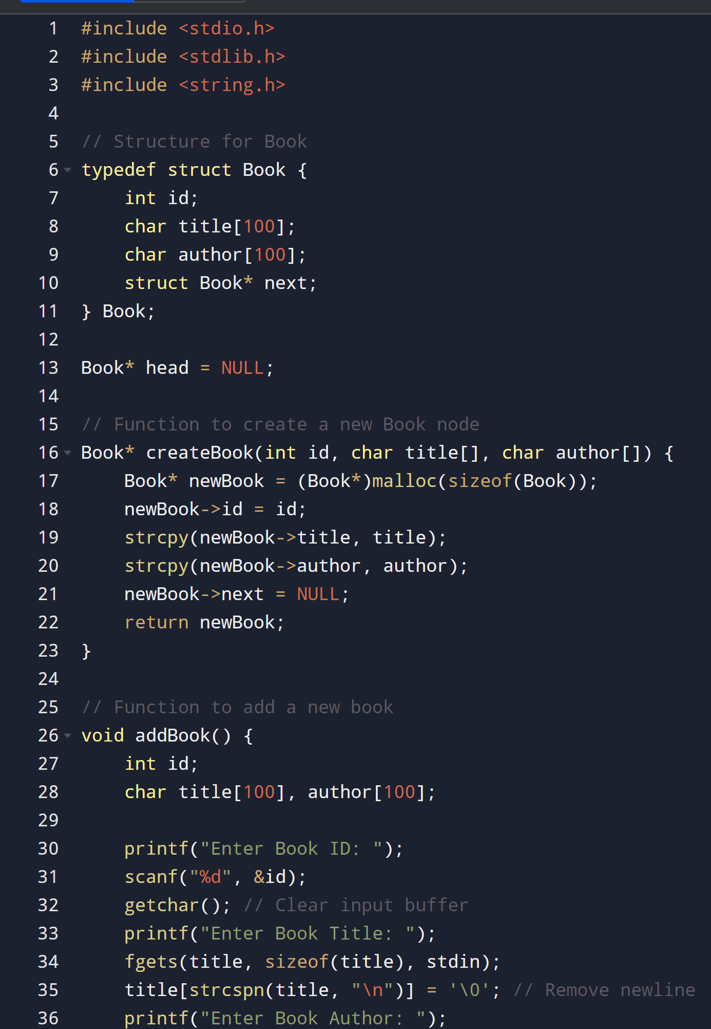
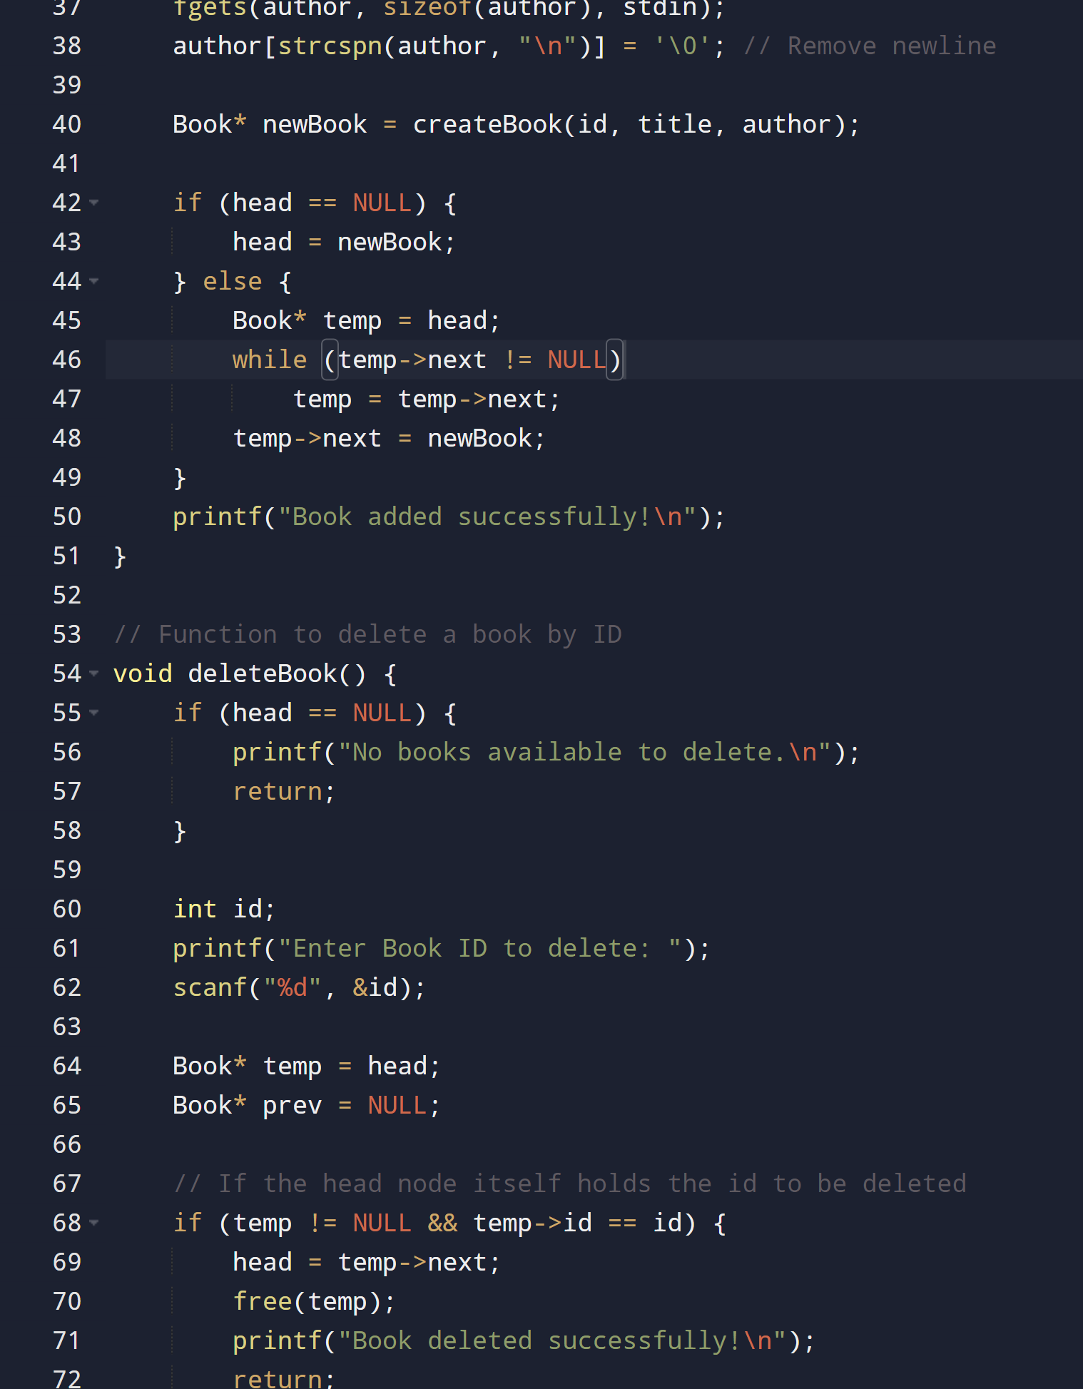
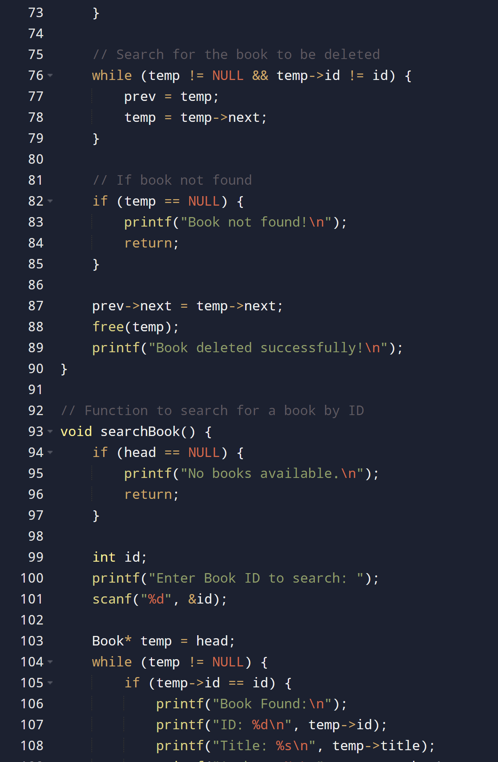
SOURCE CODE

Slide 7
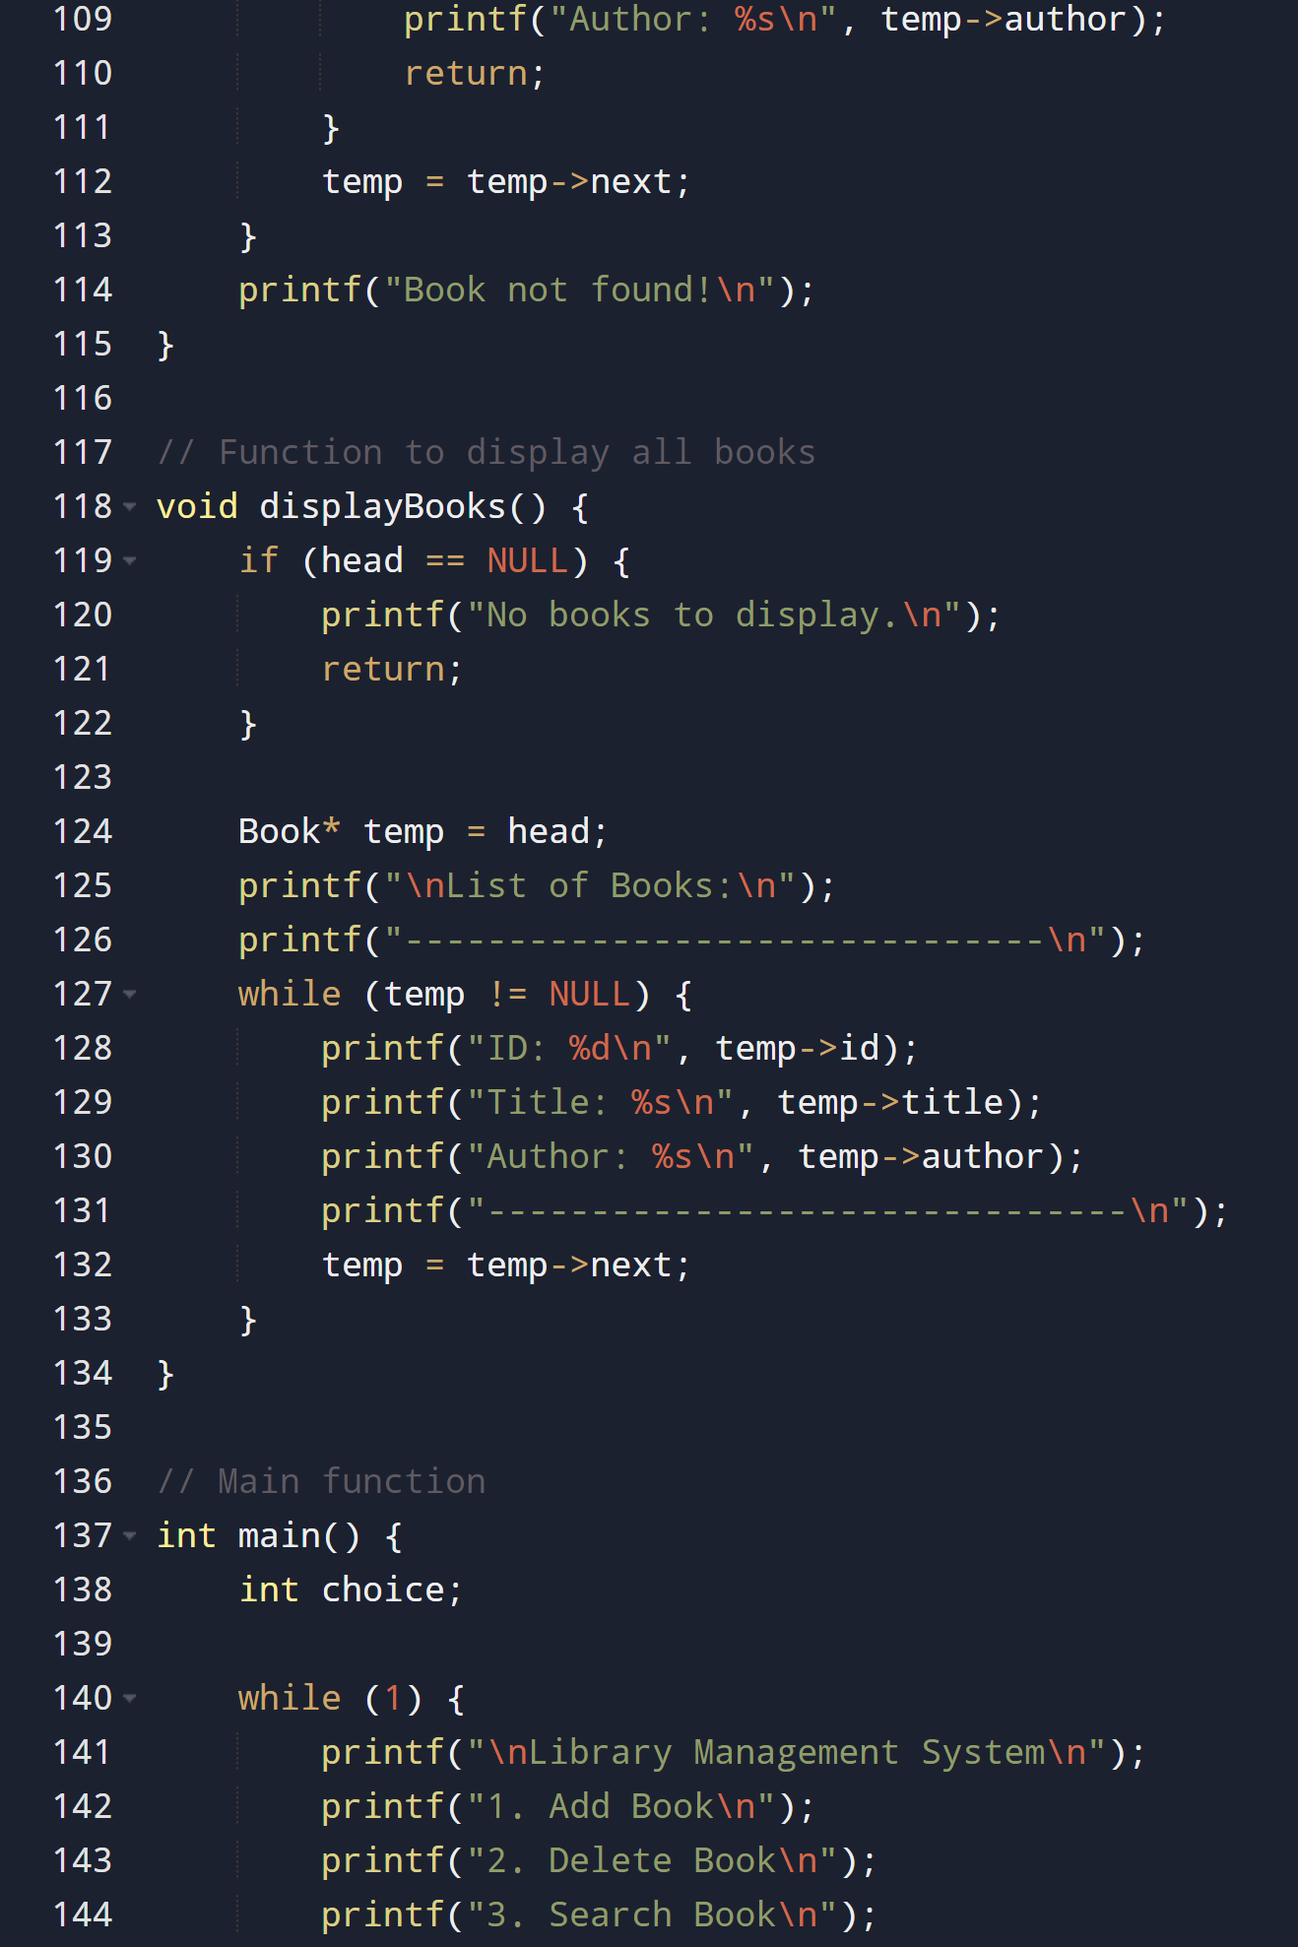
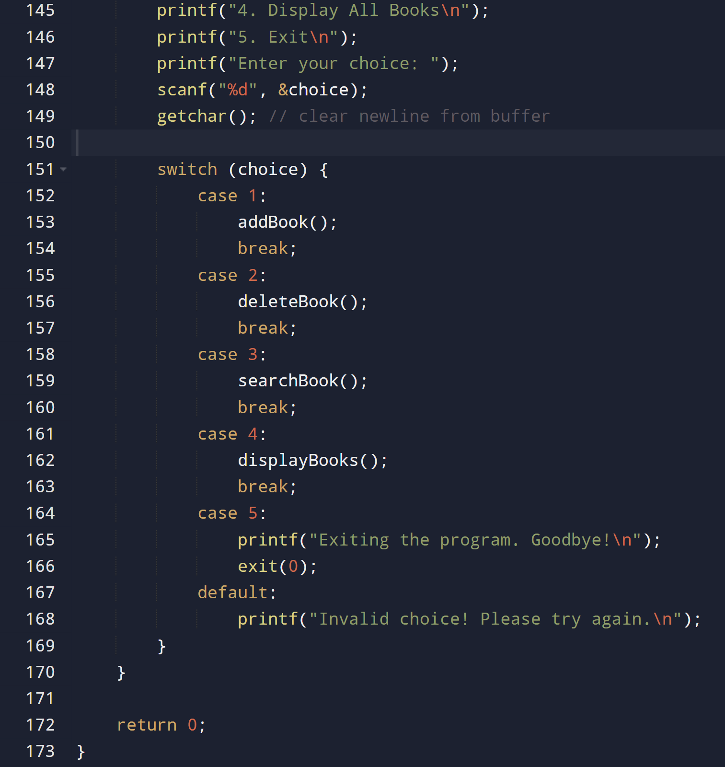
SOURCE CODE

Slide 8
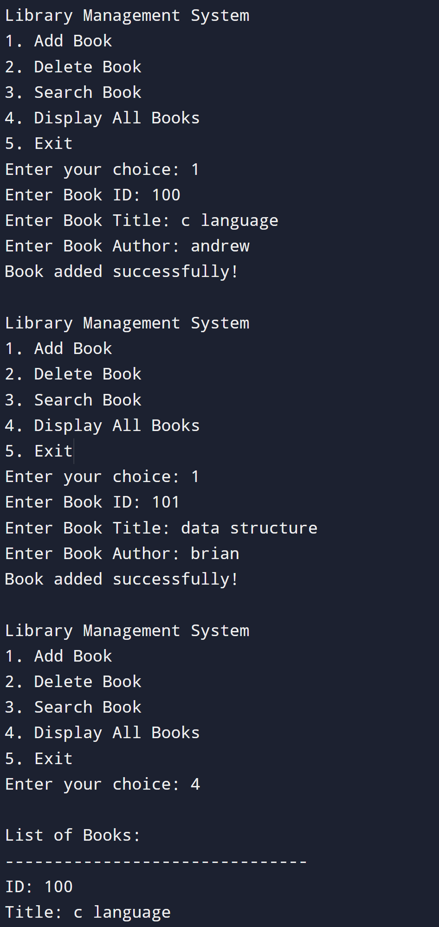
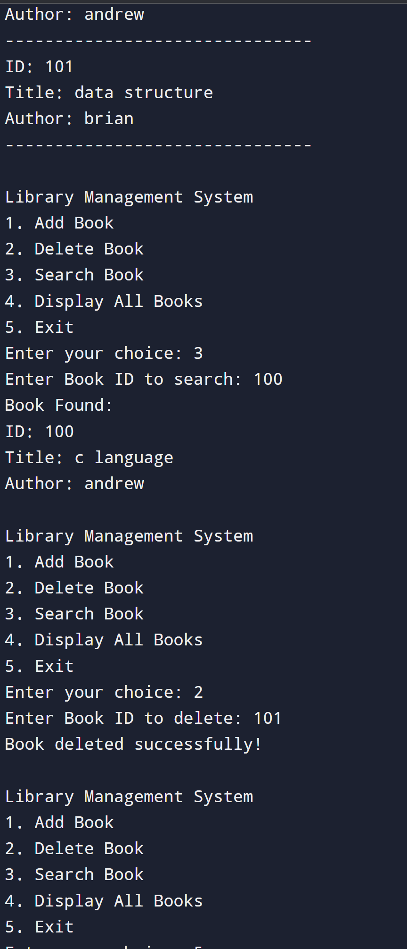
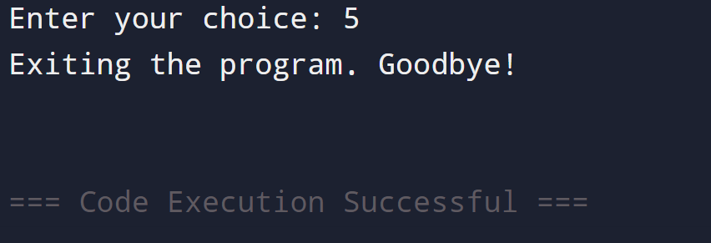
OUTPUT

Slide 9
LESSON LEARNT
Understanding Dynamic Memory ManagementYou learn how to use malloc() and free() to allocate and deallocate memory dynamically, which is essential for efficient memory usage in real-world programs.
Mastery of Pointer OperationsYou develop a deeper understanding of pointers and how they are used to create, link, traverse, and modify nodes within a list.
Realization of Data Organization and EfficiencyLinked lists show how data can be flexibly organized (e.g., adding/deleting nodes without shifting elements) and how operations differ from arrays in terms of time complexity.

Slide 10
THANK YOU

